Slide 1
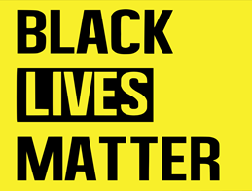
BLACK LIVES MATTER
Student’s Name
Institution Affiliation
Date of Presentation

Slide 2
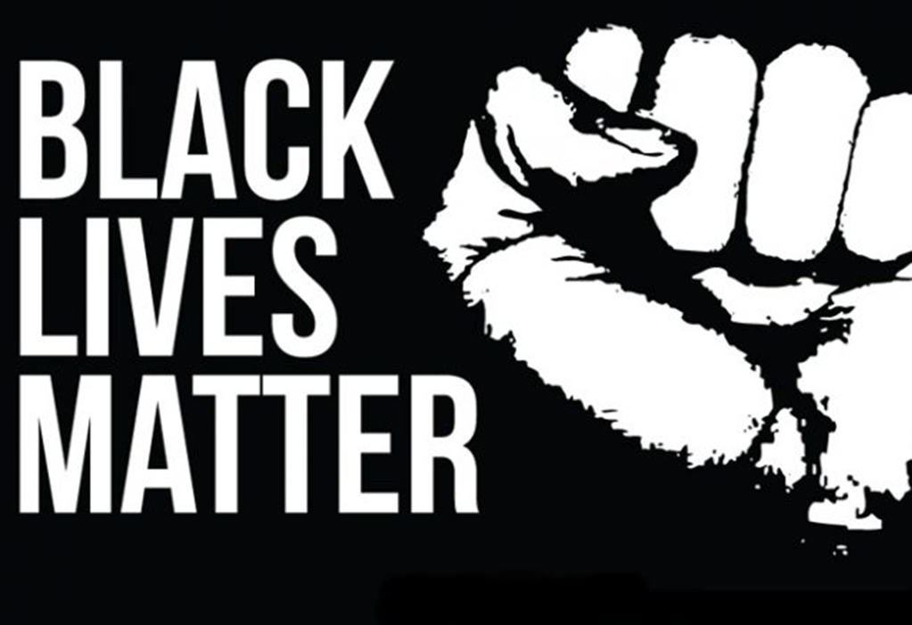
Introduction
What is Black Lives Matter?
The Black Lives Matter (BLM) is member-led organization that originated in the African-American community.
BLM mission was to build the local power, stop racism and to intervene in violence inflicted on Black communities by the state and vigilantes.
Black Lives Matter was created in 2013 by Opal Tometi, Patrice Cullors, and Alecia Garza, three woman advocates who were enraged by the exoneration of the ‘neighborhood watch” volunteer who killed a 17 year old Trevon Martin.

Slide 3
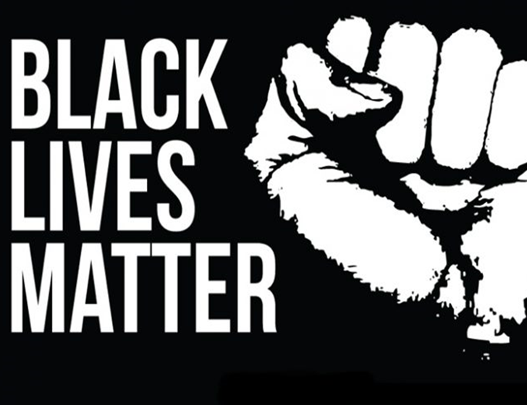
Cont..
BLM developed to a full movement during the urban uprising in Ferguson in 2014 and Baltimore in 2015.
BLM has made full use of social media as well as organized local chapters and formulated a wider political program.
It has 40 official chapters including an outpost in Canada.

Slide 4

The Purpose of the Black Lives Matter
It is a program which is divided into six categories.
It comprises of a multitude of unified petitions such as:
      Jobs and healthcare
      Tax code
      Rights to clean air
      Fair Housing
      Union Organizing
      Community control over police and schools

Slide 5

Cont..
The BLM Policy plan suggests a rational yet hypothetical progressive proposal that intends to be executed through the collaborative use of protest and politics.
It created a project called “Campaign Zero” that focuses on changing policy to police practices.

Slide 6
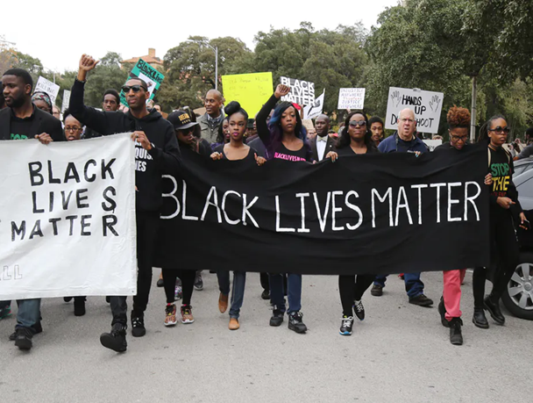
Why Black Lives Matter Movement
Globalism recognition –It considers its people as part of the global Black family who are aware of the different ways they are impacted or privileged as Black folk who exist in different parts of the world.
Ending police brutality and women identity – It address police brutality that killed many Black lives. It’s also committed to dismantle the patriarchal practices which keep Black women silent.

Slide 7

Cont..
Formation of Black Villages –It disrupts the Western-prescribed nuclear family structure requirement by supporting each other as extended families and “villages” that collectively care for one another.
Fighting for restorative justice – It ‘s committed to collectively, lovingly and courageously working vigorously for freedom and justice for Black people, and by extension, all people.

Slide 8
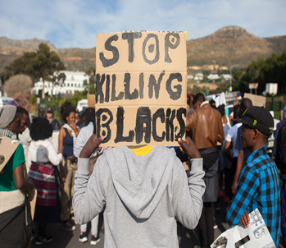
Who were involved during the Movement?
During the Movement, majority of the race involved were the Black Americans.
Black Americans were killed by police at disproportionately high rates.
This covered from Ferguson, Missouri, to St. Paul, Minnesota, and from Oakland to New York City.
The Black Lives Matter movement helped to raise public awareness of this discrepancy and of police brutality against the black people.

Slide 9
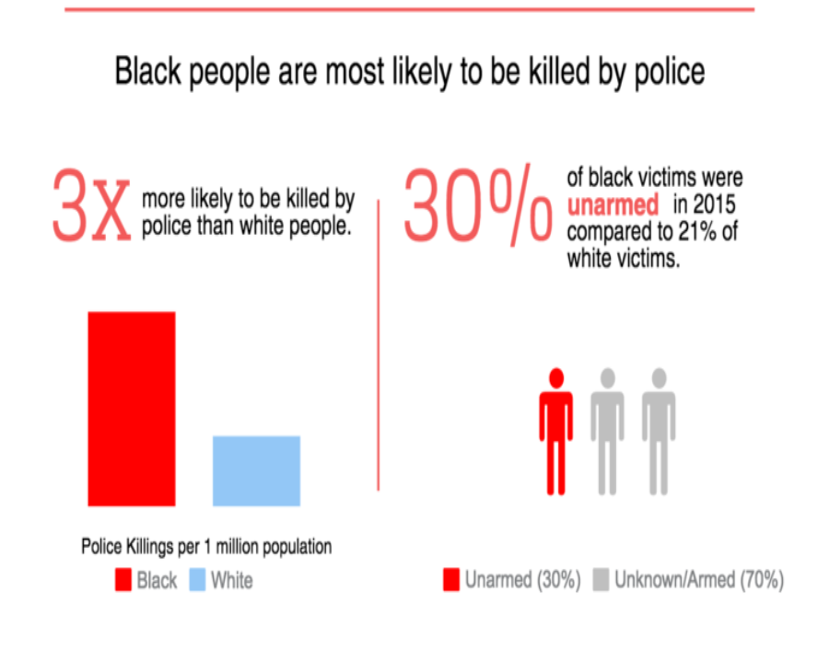
According to the article in the Washington Post, about1,502 people were shot and killed by on-duty police officers since the beginning of 2015.
A cursory glance at the numbers reveals nothing to indicate racial bias: 732 of the victims were blacks and 381 were whites while 382 were of other races.
According to Fox (2018), African Americans died at the hands of police at the rate of 7.2 per million, while whites were killed at a rate of 2.9 per million.

Slide 10
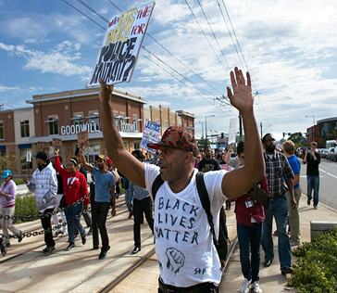
Goals and objectives of Black Lives matter
To encourage empathy for black communities.
To illustrate lingering institutional oppression, and work towards policy changes that make everyone safer.
Its objectives is to reform black activism, which has a history of elevating straight males over black women and homosexual males.
To provide training and resources to activists around the country, to encourage all of American society to value all black lives, in all instances.
Black Lives Matter protest against police brutality in St. Paul, Minnesota.

Slide 11
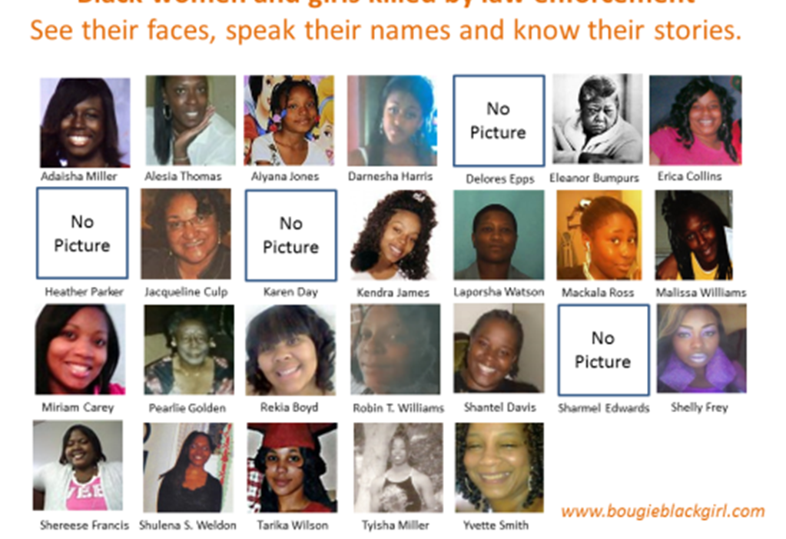
Black Women’s Blueprint
An organization based in Brooklyn N.Y that sheds light to female victims of abuse from police assaults.
Deals with racial justice, civil rights and human rights movement to center the experiences of black women and girls.

Slide 12
The Use of Videos and Dashcams
Videos are the start to finding the truth.
Videos are used in determining police use unnecessary use of violence.
According to an article “What Videos Can’t Show: Black Lives and Police Violence” (Gutting, 2016), much of this unjustified violence is due to racial violence and the Black Lives Matter supporters typically uses videos to support this conclusion.

Slide 13
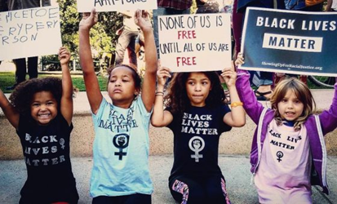
No specific age or Gender
There was no specific age during the movement but all ages were involved. Even Kids were involved in various protests.

Slide 14
Psychological Residue
According to an article “When Protesting Police Violence Puts You in the Crosshairs” (Myerson, 2017), That study reported that, out of the 565 Ferguson residents and local law- enforcement officers interviewed, members of the black community exceeded clinical cutoffs for PTSD and depression significantly more than white community members.
“While specific traumatic encounters with police can provoke mental-health problems, so can the mere awareness that the cops aren’t necessarily on your side” (Myerson, 2018, p21).

Slide 15
References
Altman, A., Rhodan, M., & Frizell, S. (2015). Black Lives Matter. Time, 186 (25/26), 116-125
Fox, M. (2018, May 07). Police killings hit people of color hardest, study find. NBC News. Retrieved from
http://www.nbcnews.com/health/health-news/police-killings-hit-people-color-hardest-study-finds n872086
Gutting, G. (2016). What videos can’t show: Black live and police violence. Commonweal, 143(18), 12-14
Joseph, P. E. (2017). Why Black Lives Still Matter (Cover Story). New Republic, 248 (5), 16-19
Meyerson, C. (2017). When protesting violence puts you in the crosshairs. The Nation, 305(16), 16-21

